Slide 1
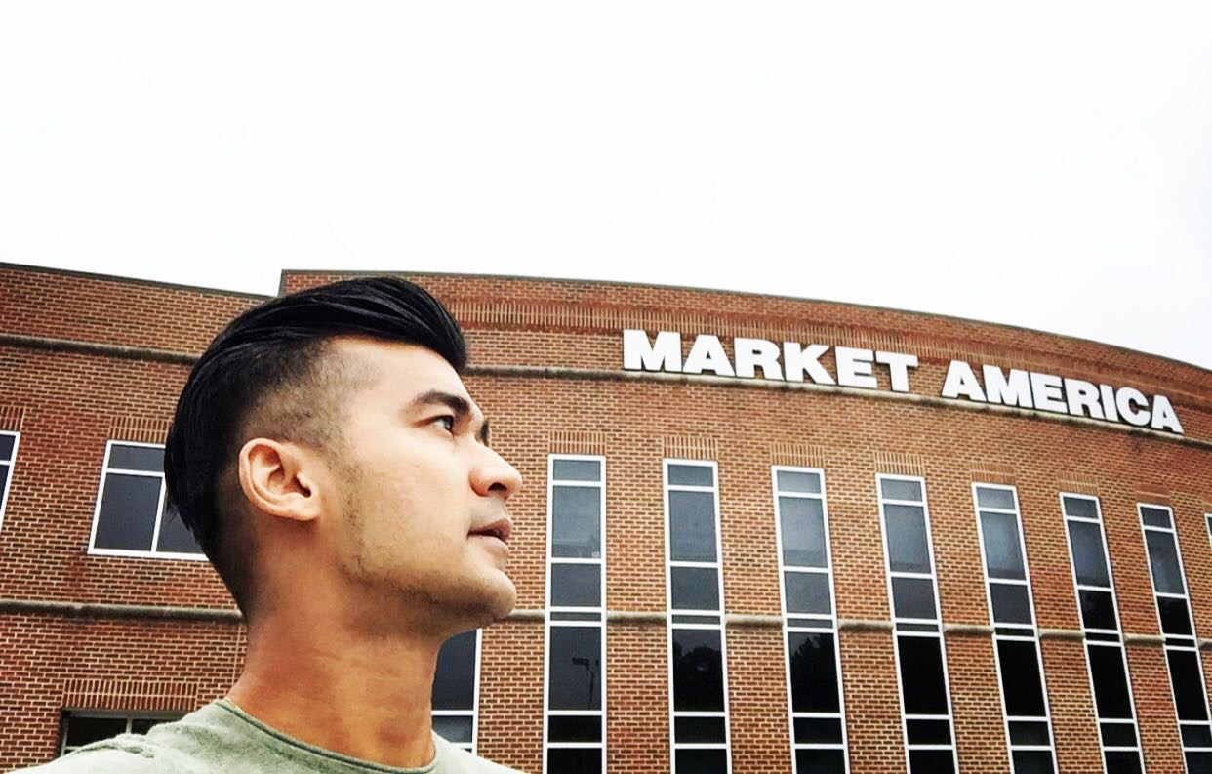
MASG journey
My exhilarating

Slide 2
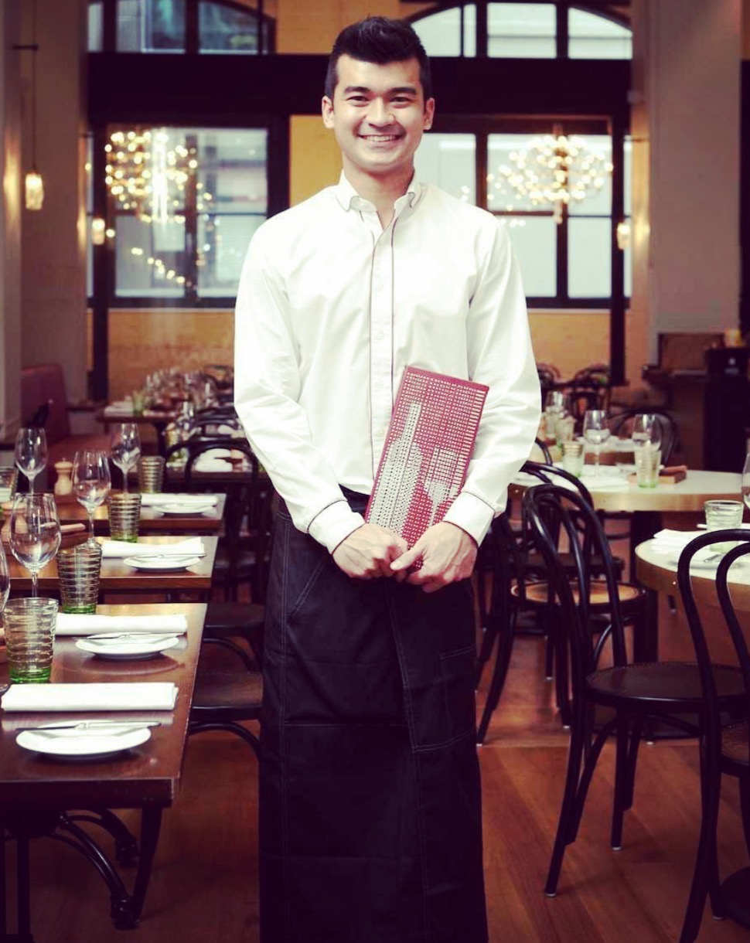
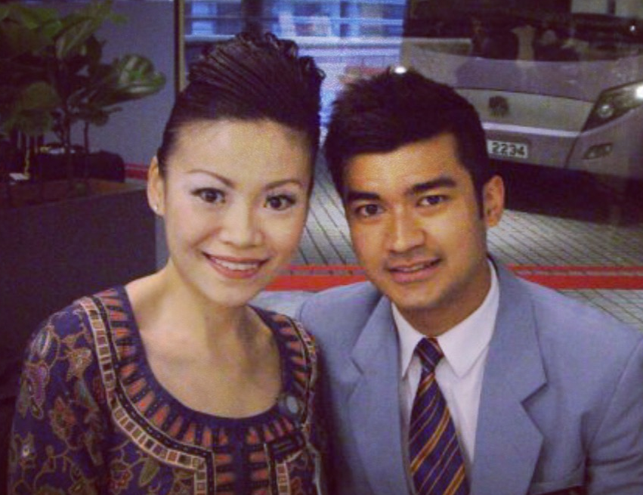
MELBOURNE AUSTRALIA

Slide 3
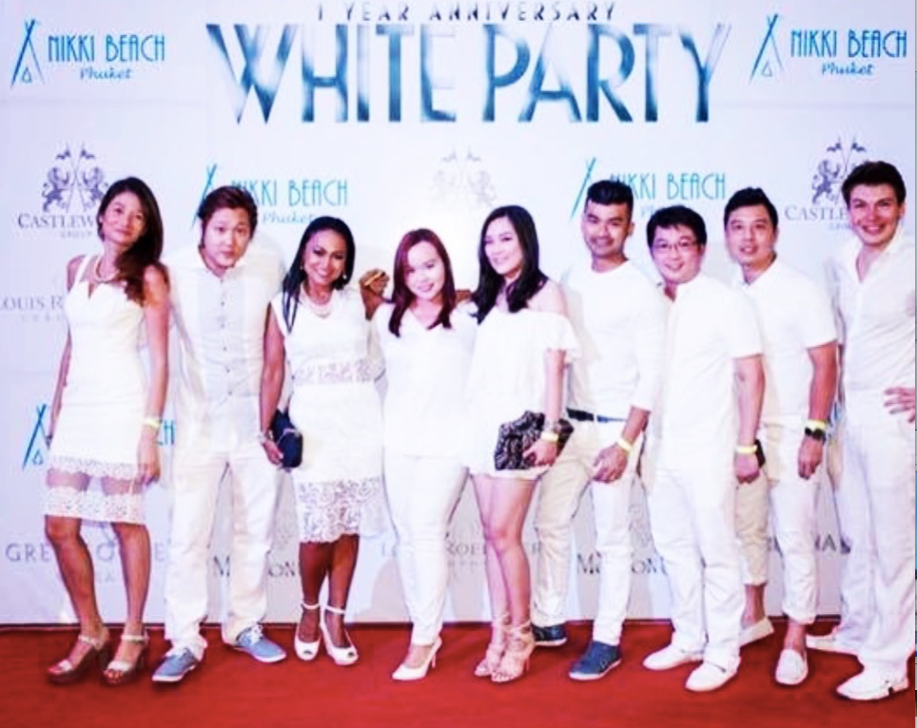
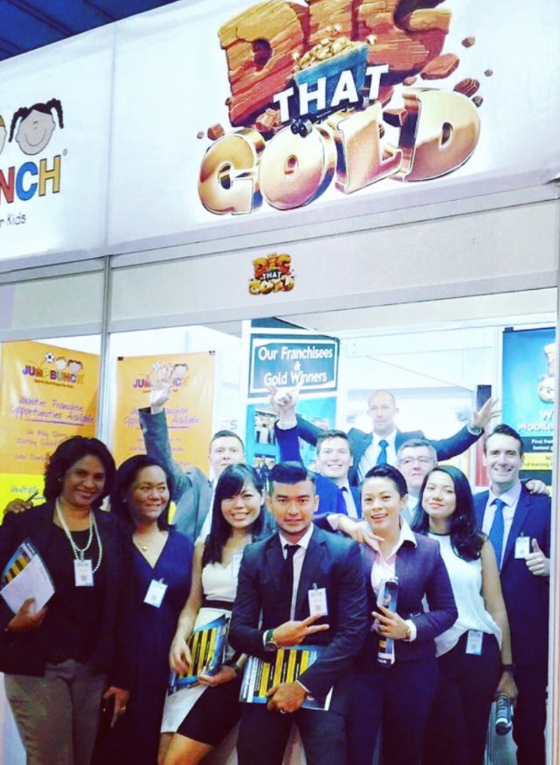
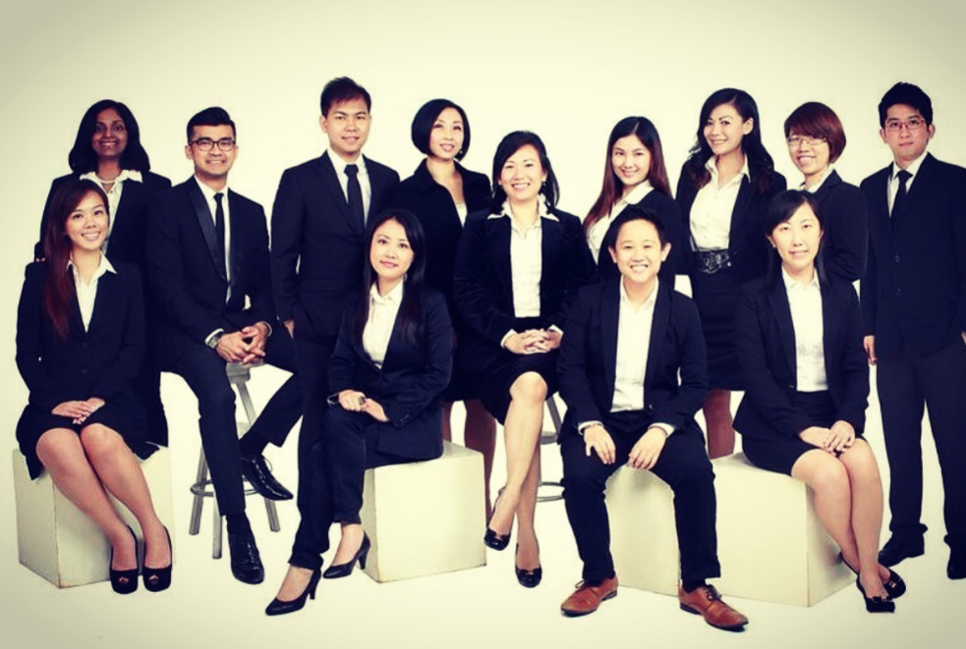

Slide 4
Always aspire to be a
Full Time Stay Home Dad

Slide 5
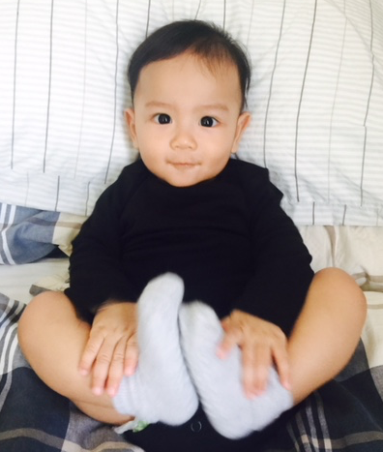
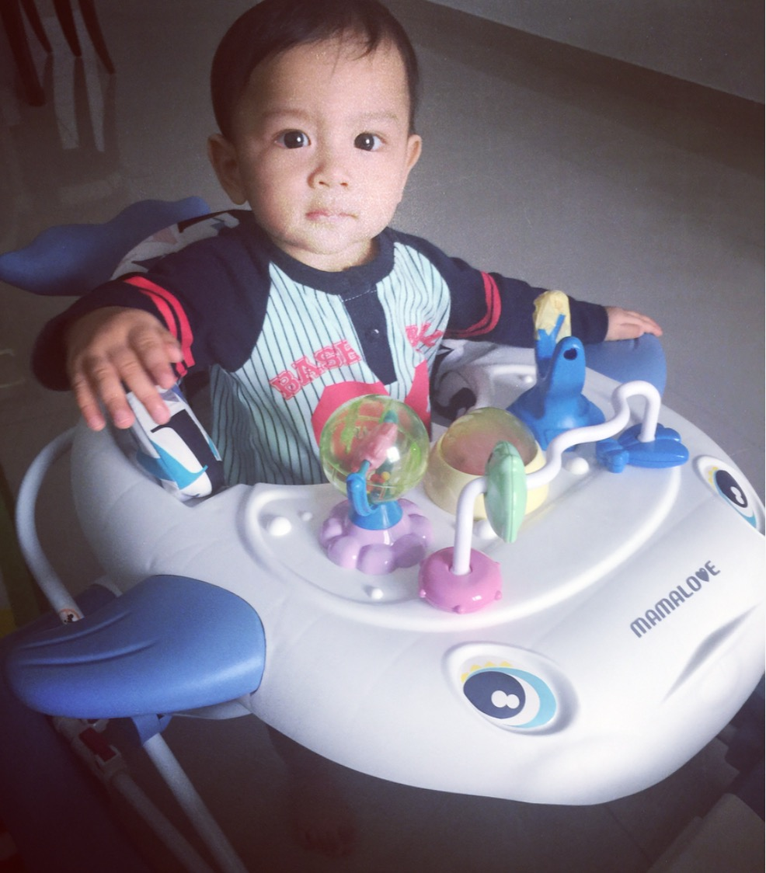
Tristan
Notes:
Found the Business by chance in Feb 2016.
News of the arrival of my son was coming in Sep 2016 and its been a dream to be a Stay Home Dad, to watch my son grow up.

Slide 6
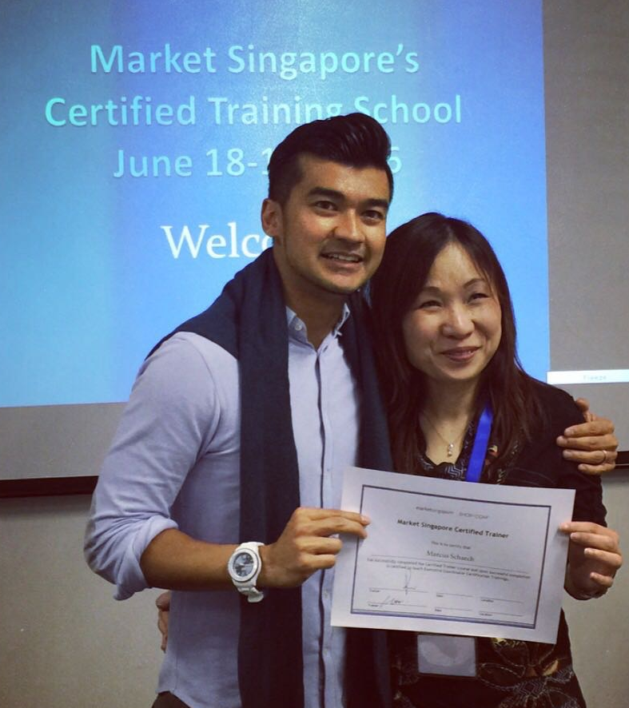
GMTSS CERTIFIED
TRAINER

Slide 7
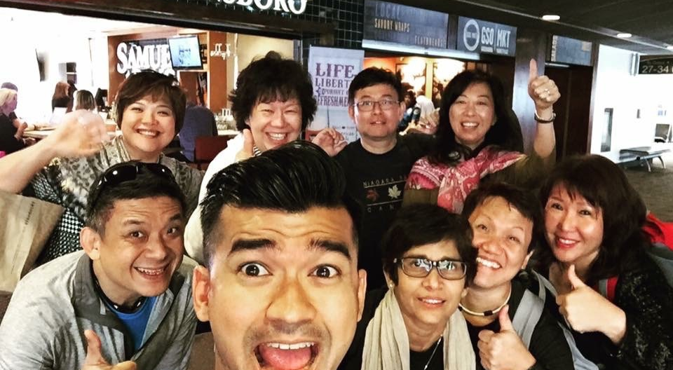
CAUGHT THE VISION IN GREENSBORO
MAIC 2016

Slide 8
SHOP.COM
IN MY DNA
FULL TIME
INTO THE BUSINESS
IN SEPTEMBER 2016

Slide 9
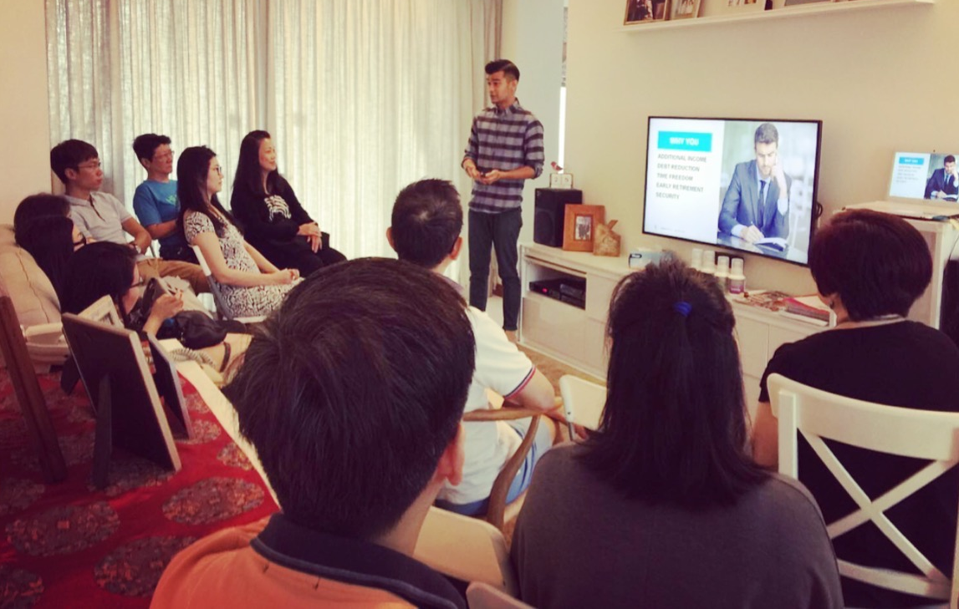
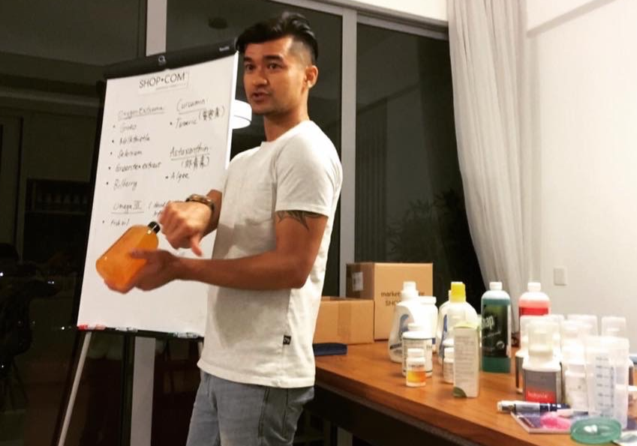
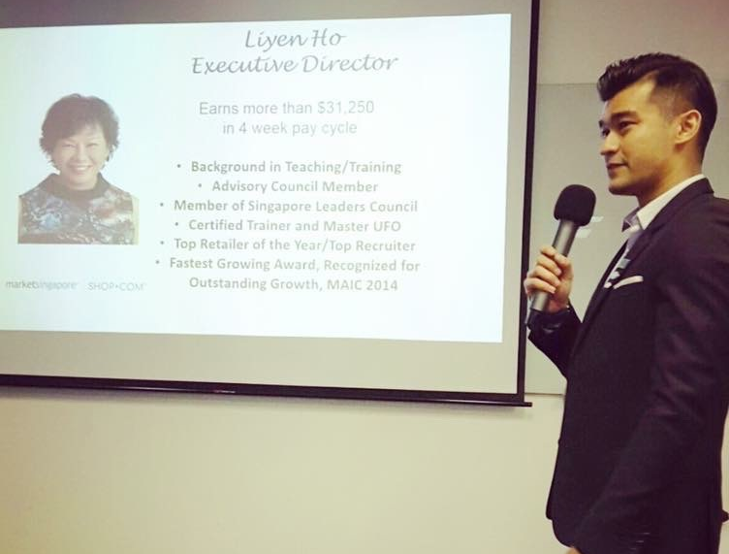
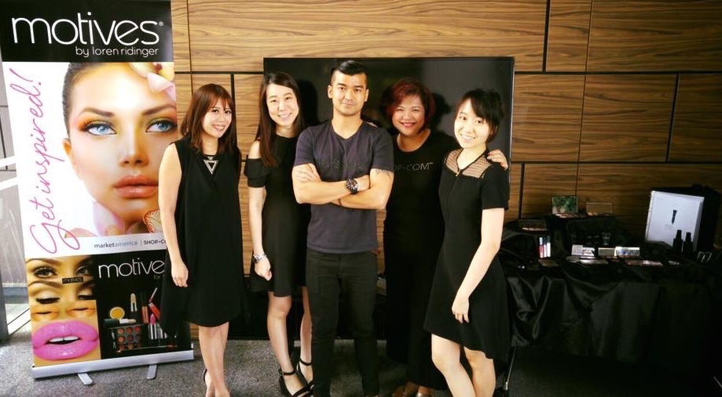
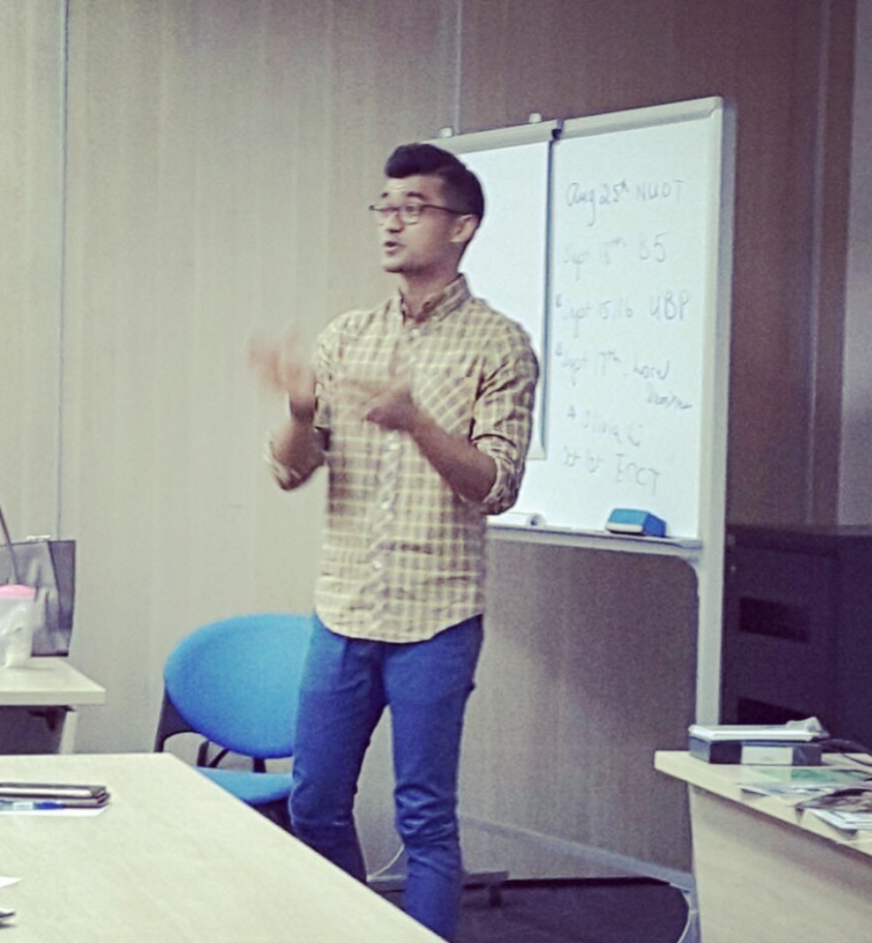
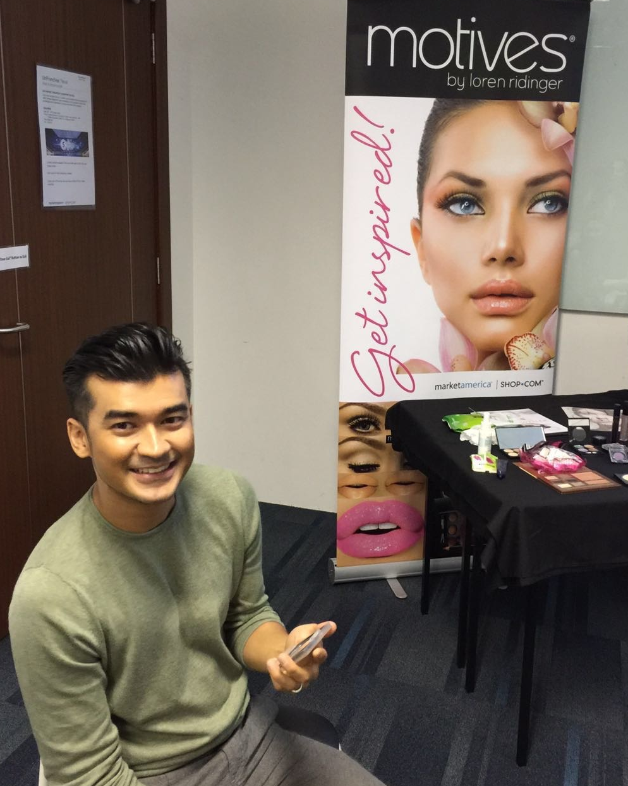
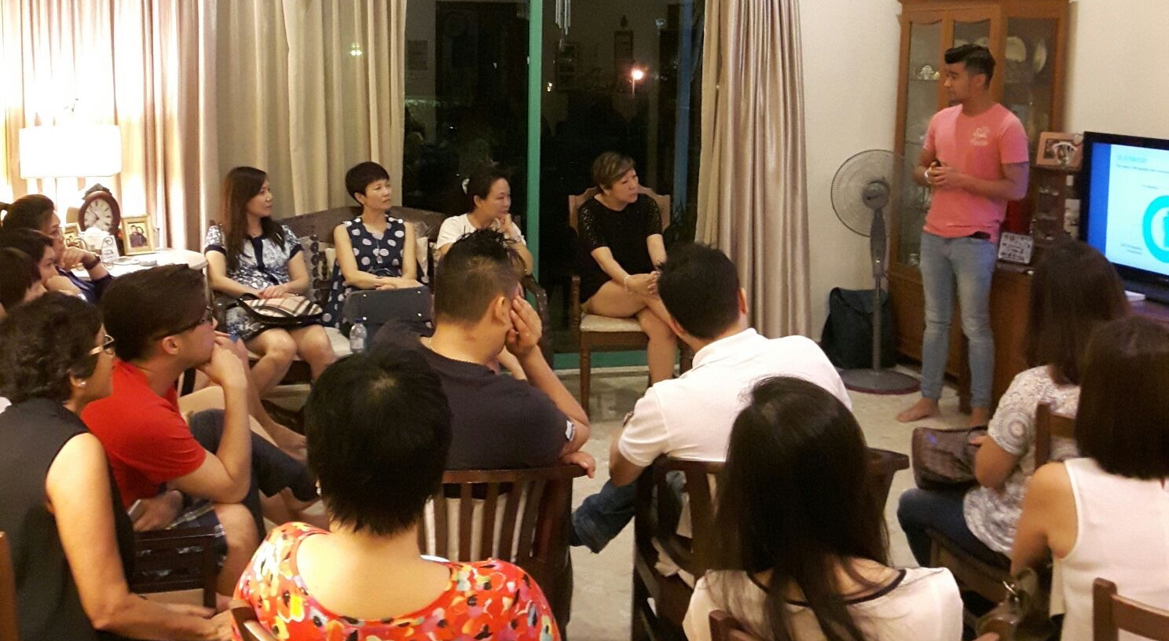
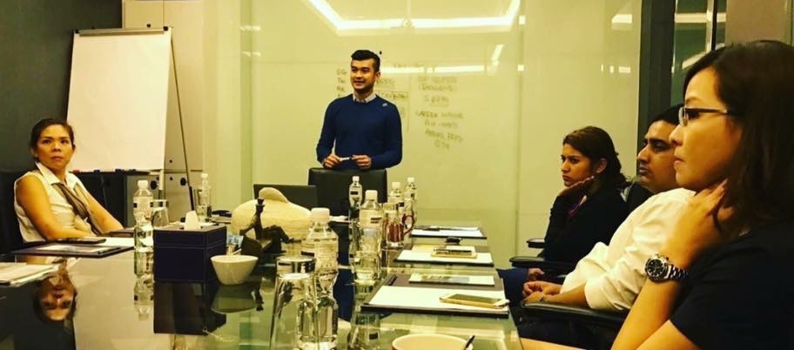

Slide 10
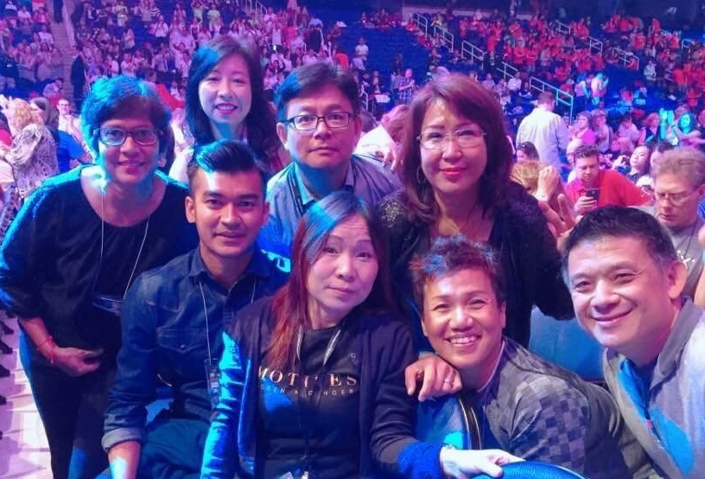
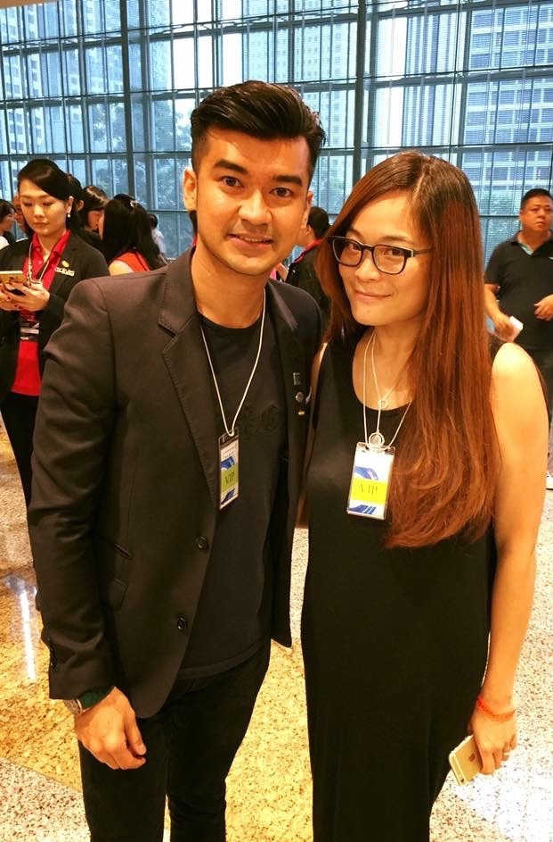
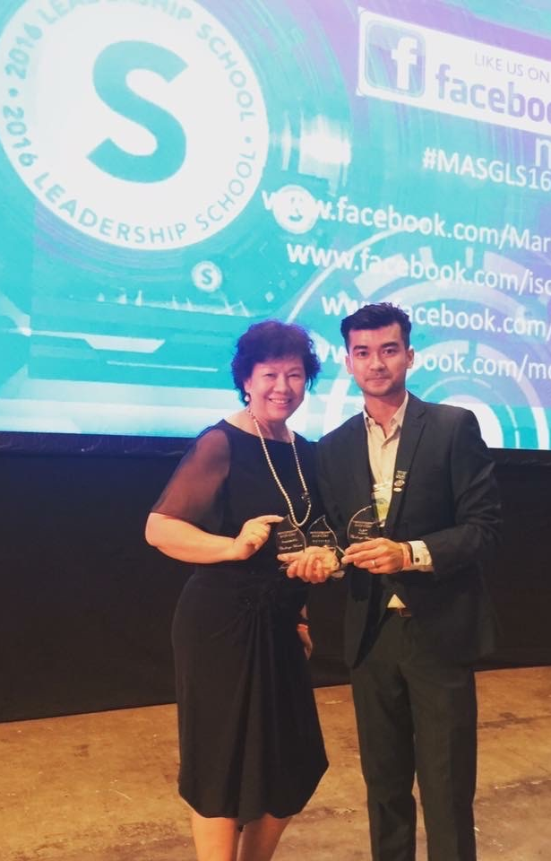
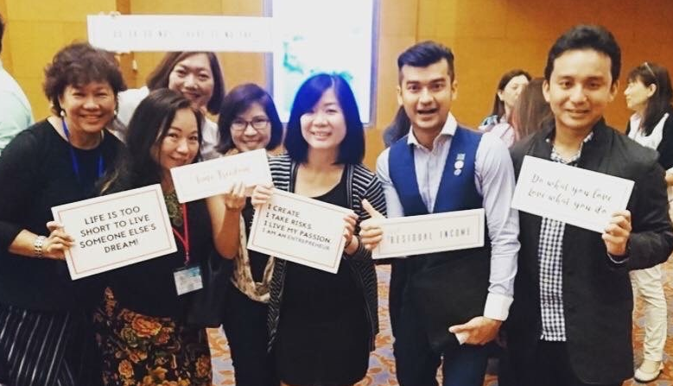

Slide 11
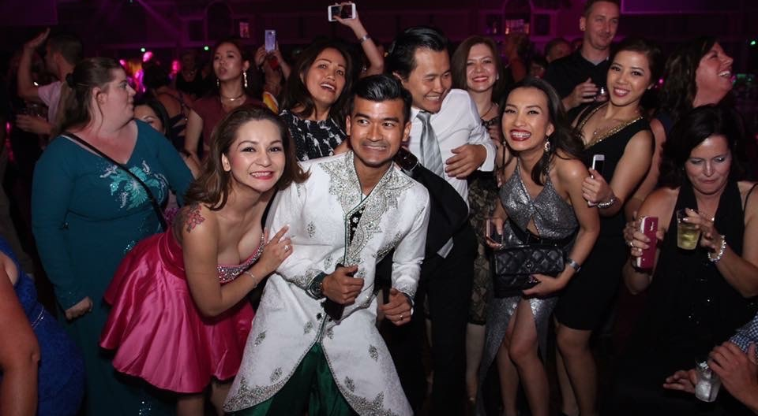
THE JOURNEY IS SUCH A JOY

Slide 12
PIN LEVEL RECOGNITION
UFO 16th Feb 2016
Coordinator 8th April 2016
Executive Coordinator 3rd June 2016
Master Coordinator 27th Jan 2017
Senior Master Coordinator 17th Feb 2017

Slide 13
MY ACCOMPLISHMENTS
Marcus Schaech
Senior Master Coordinator
Earning S$3,750 - S$5,625 in a 4-week pay cycle
MASG Certified Trainer
Speakers Bureau II
Leadership President’s Challenge Winner 2016
Motives® and TLS Challenge Winners 2016
Annual Convention Chairman Challenge Winner 2017
International MAIC Chairman Challenge Winner 2017
Leadership Chairman Challenge Winner 2017
Motives Certified Beauty Advisor
6 x Master UFO Qualifier
6 x Shopping Annuity Master Member
Disclaimer:
The income levels mentioned in this presentation are for illustration purposes only. They are not intended to represent the income of any typical Market Singapore® UnFranchise® Owner, nor are they intended to represent that any given UnFranchise® Owner will earn income in that amount.
The success of any Market Singapore® UnFranchise® Owner will depend upon the amount of hard work, talent, and dedication which he or she devotes to building his or her Market Singapore® Business.

Slide 14
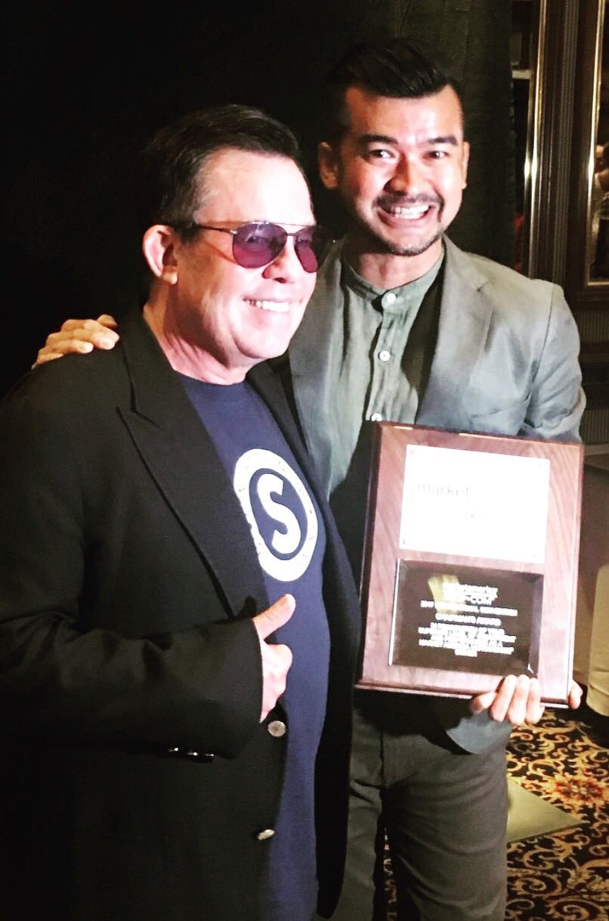
THE SPECIAL MOMENT
25th MAIC 2017

Slide 15
SUCCESS TIPS
BE COACHABLE
LISTEN
LEARN
FOLLOW
BE CONSISTENT
GMTSS
RETAILING
RECRUITING
EMPOWER OTHERS
TEACH
MANAGE
SUPPORT
BE COMMITTED
CORINGS
SEMINARS
CONVENTIONS

Slide 16
IMPORTANCE OF EVENT TICKETS
Keys to success
Trainings by Power profiles, corporate team & other successful business partners!
The 80 hours clocked in a convention in America can never be duplicated by just one leader, no matter how empowered they are

